Slide 1
Python Image Processing & Machine Learning
Summer 2020 Project

Slide 2
Outline
Intro
Problem? We need accurate live classification
Goal
Machine learning
Robust classification
Accuracy metric: for specific mutants
Robustness metric: across mutants
Reliable gtruth
Compare with different algorithms
Starting point
Worm images w/gtruth
Five target features
Extracted features
Machine learning techniques
Classification techniques
LDA and SFS
Conclusion & future goals based on what I have done

Slide 3
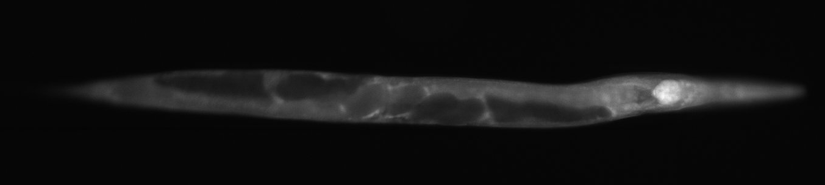
Accurate live body classification
Image worms of different strains
Properties
Single loaded
Whole animal
Straight
Clear
Head first (nerve ring visible on the right)
Correct position

Slide 4

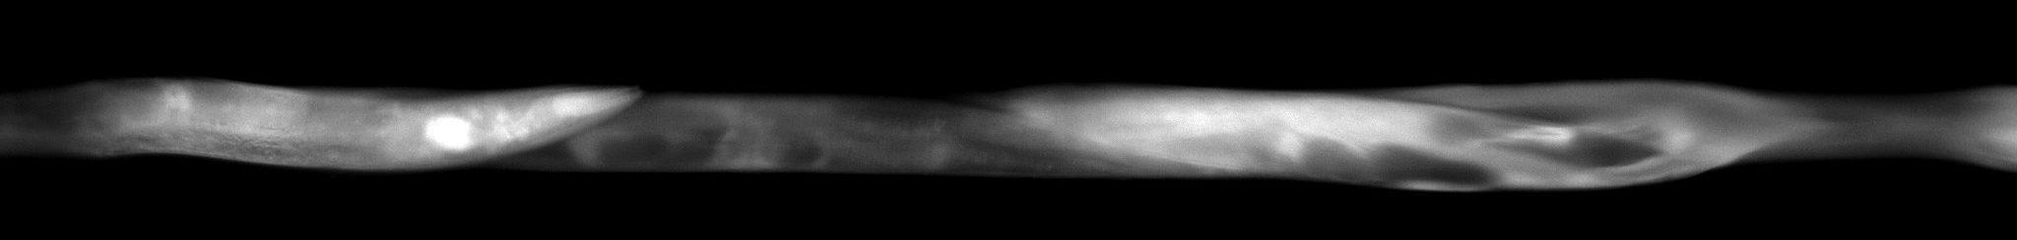
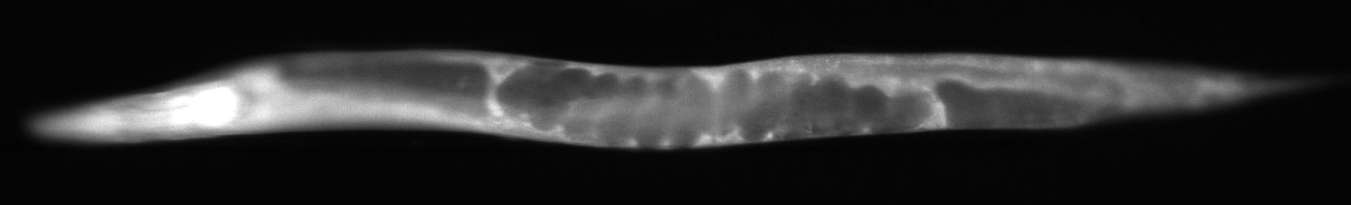
Accurate live body classification
Problem: We have images of worms that are not uniform, but we want to be able to use this images to identify differences between strains. How do we create a model to filter out all of the undesirable images and only keep the best images?
Coiled
Multiple loads
Tail first

Slide 5
Goals
Gain an understanding of machine learning
Robust classification
Obtain reliable ground truth
Generate feature extraction algorithm to analyze images
Use extracted features to create classifiers for new images
Accuracy metric: for specific mutants
Robustness metric: across mutants
Compare different classifiers

Slide 6
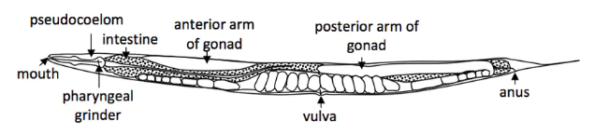
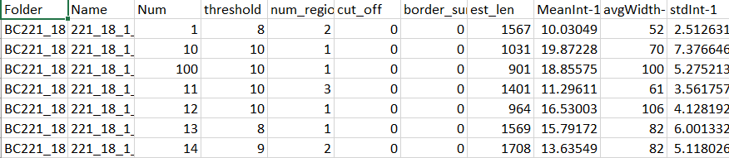
Coding workflow
Ground Truth
Worm Image
Feature Extraction
Goal: Train a model/classifier to use features extracted from each image in order to predict five target features – single loaded, whole animal, straight, headfirst, and clear.
Feature Exploration
Feature Selection
PCA and Heat Maps
LDA, Stepwise Logistic Regression

Slide 7
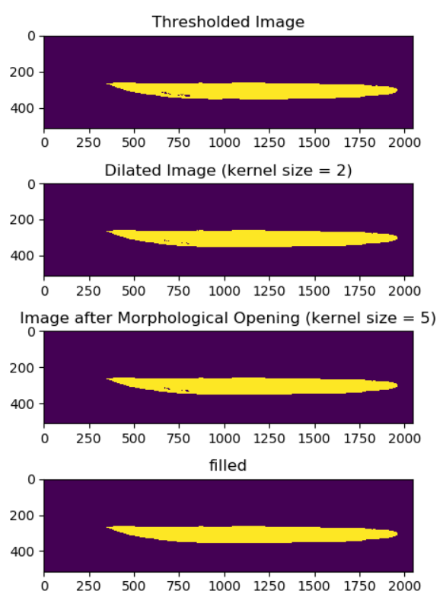
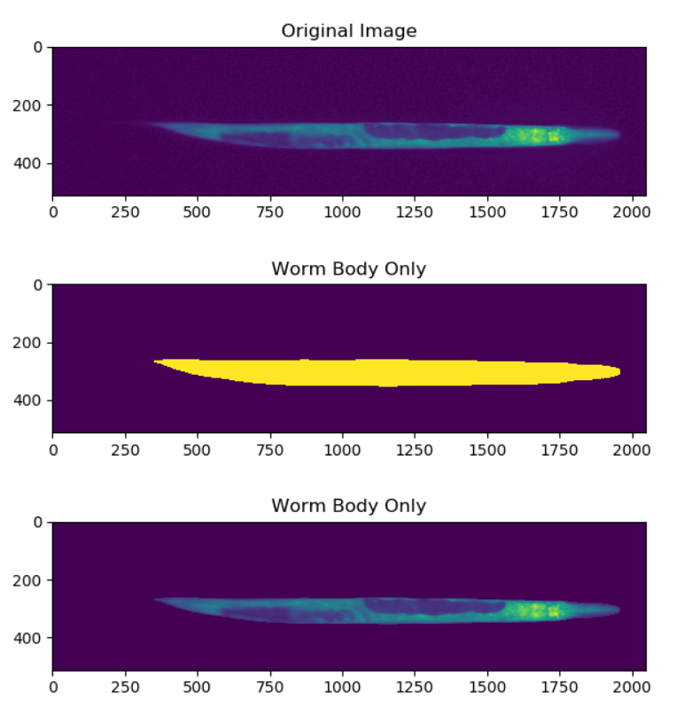
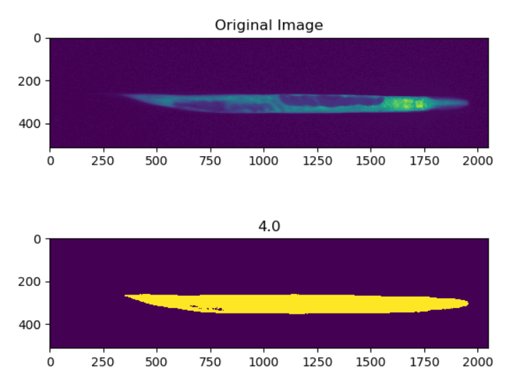
I m a g e P r o c e s s i n g
Dilation, opening, and filling
Multiply mask with original image
Otsu’s Thresholding
Notes:
Otsu’s thresholding: identifies the ideal threshold at which the image matrix can be binarized into background (0) and foreground (1)
Take Otsu’s threshold value and make it smaller by a factor of 0.475 (determined by trial and error of which threshold factor value worked the best – don’t want too much lenience but also don’t want too many holes).
Dilate and open the image to remove small figures or holes but maintain the overall body of the worm. Then fill holes (all done with CV2 and scipy).
Then select the largest region of foreground (1s) and can multiple that image by the original image. All background will have a value of 0 and all foreground (or worm body) will have the original image value. Mask * original = worm only
[0 0 0] * [0 0 0] = [0 0 0]
[0 1 1] * [0 2 1] = [0 2 1]
[0 1 0] * [2 3 0] = [0 3 0]

Slide 8
Final image
Dilation, opening, and filling

Slide 9
Workflow
Ground Truth
Worm Image
Feature Extraction
Goal: Train a model/classifier to use features extracted from each image in order to predict five target features – single loaded, whole animal, straight, headfirst, and clear.
Feature Exploration
Feature Selection
PCA and Heat Maps
LDA, Stepwise Logistic Regression

Slide 10
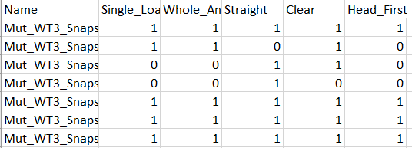
Combine data
Import data as pandas data frames and merge ground truth with our extracted features based on image name

Slide 11
Workflow
Ground Truth
Worm Image
Feature Extraction
Goal: Train a model/classifier to use features extracted from each image in order to predict five target features – single loaded, whole animal, straight, headfirst, and clear.
Feature Exploration
Feature Selection
PCA and Heat Maps
LDA, Stepwise Logistic Regression

Slide 12
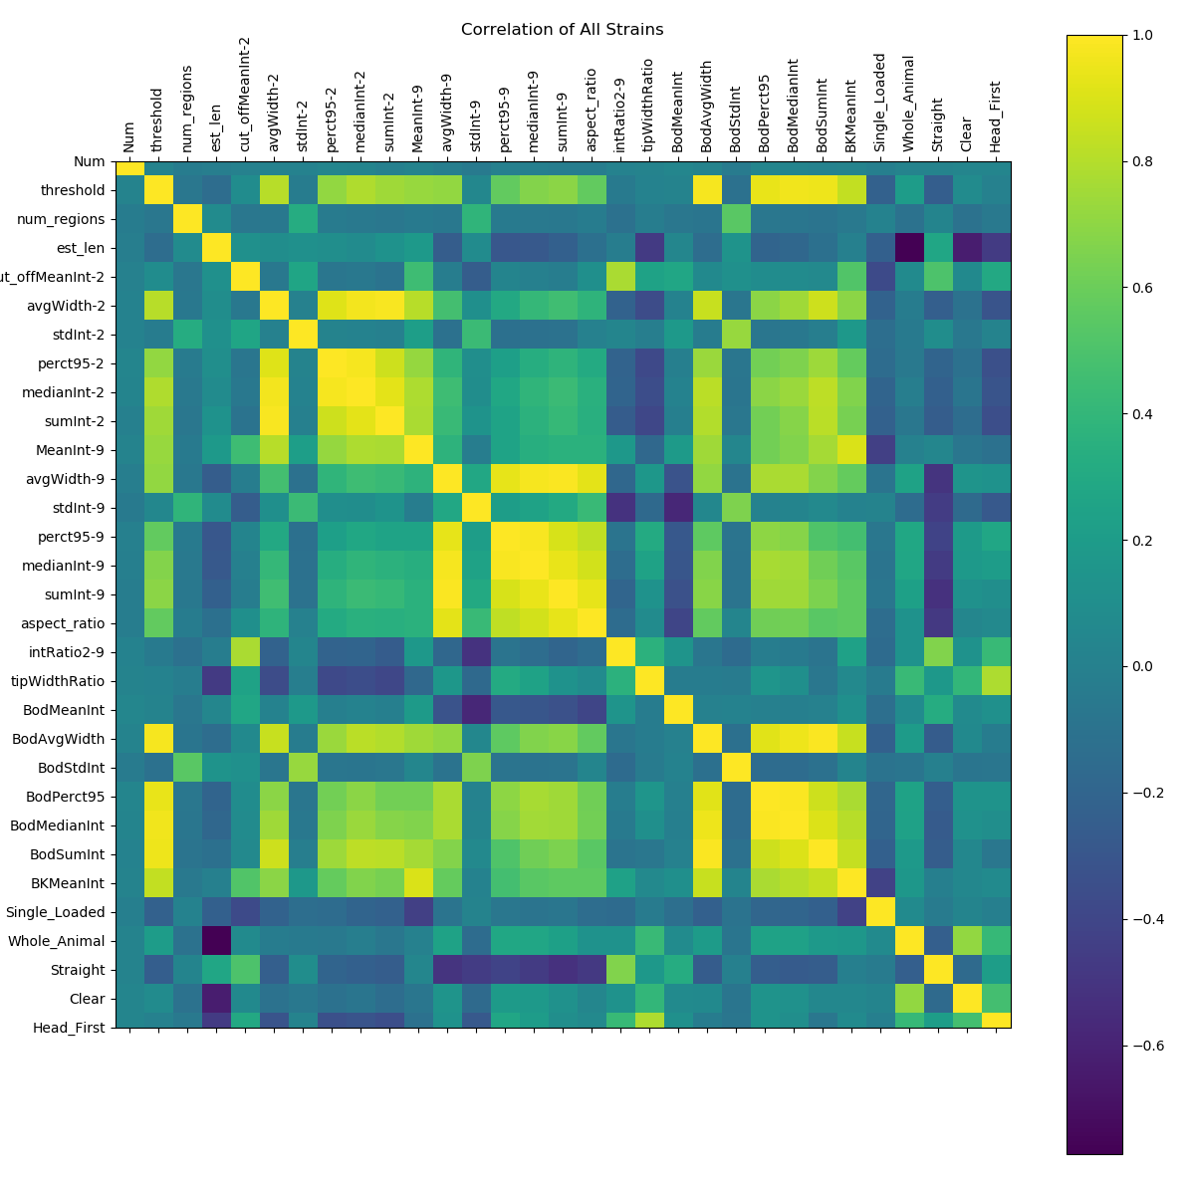
Correlation
Pandas module has easy correlation functions.
How does each extracted feature correlate with each of the five target features?

Slide 13
PCA
PCA projects your data onto a given number of orthogonal principal components (PCs), where PC1 describes the most variance in the data, PC2 describes the second most variance in the data, etc.
We computed eight PCs from the extracted features and correlated those to each of our five target features to determine which PCs

Slide 14
Workflow
Ground Truth
Worm Image
Feature Extraction
Goal: Train a model/classifier to use features extracted from each image in order to predict five target features – single loaded, whole animal, straight, headfirst, and clear.
Feature Exploration
Feature Selection
PCA and Heat Maps
LDA, Stepwise Logistic Regression

Slide 15
Test-train-split: machine learning basics
Before doing training any classifiers, use sklearn’s test-train-split function, which splits your data into testing and training sets (can set desired size of these data).
Train
Test

Slide 16
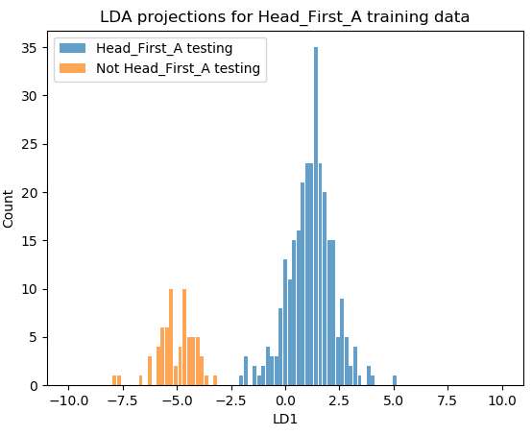
LDA
Similar to PCA in that it projects data onto orthogonal axes. For binary data (like our five target features, either 0 or 1) can only project to one dimension

Slide 17
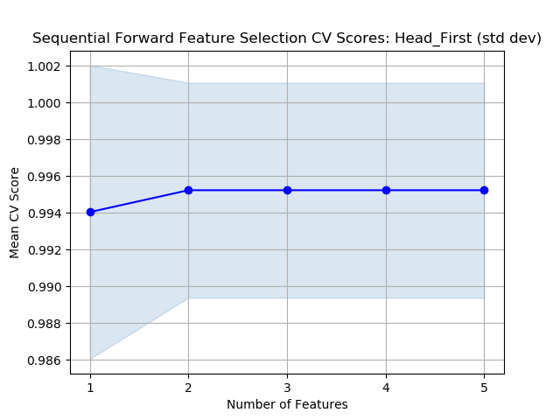
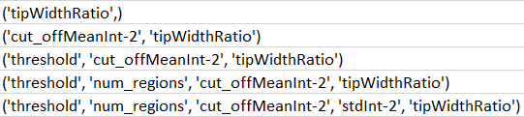
SFS
At each step, SFS adds the variable that gives the most statistically significant improvement of the fit of the SFS model/classifier
Headfirst: SFS Chosen Features

Slide 18
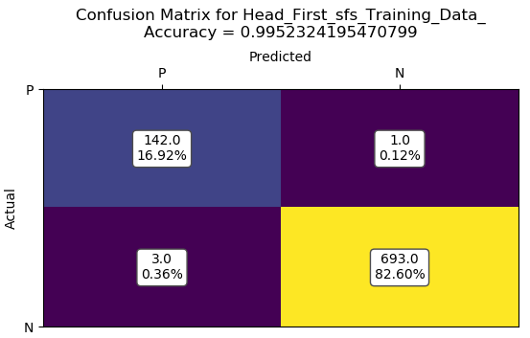



Accuracy/CV metrics
This is where the training set comes back into play. Confusion matrices (while they can be limited by unbalanced data) give us a general idea of how many times the classifier correctly identifies our five target features.
Notes:
Accuracy in figures is the number of true pos/neg divided by the total number of predictions

Slide 19
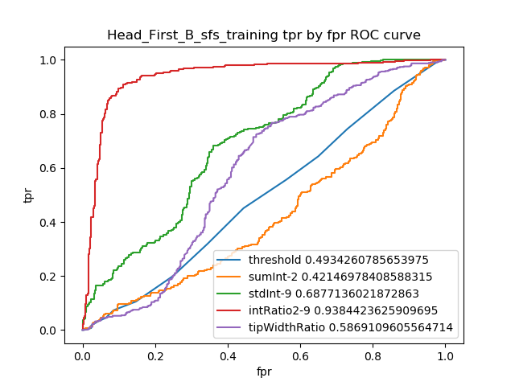
Accuracy/CV metrics
ROC-AUC: Good for binary classification problems and takes into account both the true negatives and true positives (the greater the area under the curve, the more true positives you get for every false positive)

Slide 20
Tools
Sublime text editor, Ubuntu, README, Github, Excel
Python modules
Argparse for cmd arguments
CV2 and scipy for image importation and processing
Numpy, Excel Writer, and pandas for data organization
Mlxtend and scikit-learn for data processing and analysis
Matplotlib for data presentation
Feature exploration techniques
Heatmap/confusion matrices
PCA
Feature selection techniques
Linear Discriminant Analysis
Step-forward Sequential Feature Selection
Validation/accuracy metrics
Test-train-split
Balanced accuracy score, F1 score, ROC-AUC, confusion matrices

